Slide 1
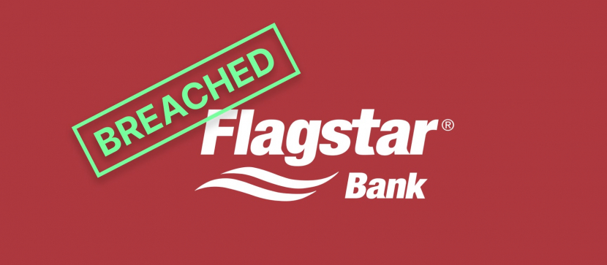

Flagstar bank
Nicholas Catani ISM-6331

Slide 2
Content
BREACHED
FLAWED
DISCOVERY
WISDOM
REMEDIES
CUSTOMER’S ACTION
REFERENCES
SLIDE 2
SLIDE 3
SLIDE 4
SLIDE 5
SLIDE 6
SLIDE 7
SLIDE 8
SLIDE 1

Slide 3
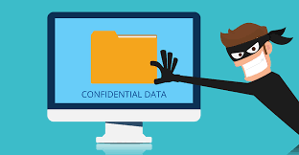
BREACHED
Cyber intruders breached the bank’s corporate networks – security incident.
The ransomware gang (CLOP) breached Accellion file transfer appliance by exploiting a zero-day vulnerability. It resulted in an indirect compromise of Flagstar client and employee data.
Social Security Numbers
Home Addresses
Tax Records
Phone Numbers
SLIDE 2

Slide 4
FLAWED
Flagstar Bank failed to implement sufficient protection protocols in time.
Sued for inadequate security measures to secure, protect, and safeguard customers’ Personally Identifiable Information against unauthorized access and disclosure.
https://topclassactions.com/lawsuit-settlements/privacy/data-breach/flagstar-class-action-alleges-bank-failed-to-safeguard-customer-information-in-data-breach/
SLIDE 3

Slide 5

DISCOVERY
It took 6 months through extensive forensic investigation and manual document review to detect the breach, and circumstances are still unclear. Company’s spokesperson Susan Bergesen, when reached, declined to provide answers.
SLIDE 4

Slide 6

REMEDIES
Activate incident response plan
Engaged external cybersecurity professionals
Reported the matter to federal law enforcement
(1.5M of customers will receive free identity theft monitoring for 2 years)
A single plan cost $9 to $25 per month.
If gets average, $17 per month is $204 yearly per person.
($204 x 2years) x 1.5M = $612M
SLIDE 5

Slide 7




CUSTOMER’S ACTIONS
Monitor their financial statements
Request a free credit report
Place a security freeze on their credit file
(someone sued the financial institution)
SLIDE 6

Slide 8




WISDOM
Annual penetration test
Security audits
Update incident response plans
Provide extensive cybersecurity training
SLIDE 7

Slide 9
References
https://www.cnet.com/tech/services-and-software/social-security-numbers-stolen-in-flagstar-bank-data-breach/
https://www.bleepingcomputer.com/news/security/flagstar-bank-discloses-data-breach-impacting-15-million-customers/
https://www.wbay.com/2022/06/30/flagstar-bank-announces-data-breach-impacting-15-million-customers/
https://techcrunch.com/2022/06/21/flagstar-bank-social-security-numbers/
SLIDE 8

